Slide 1
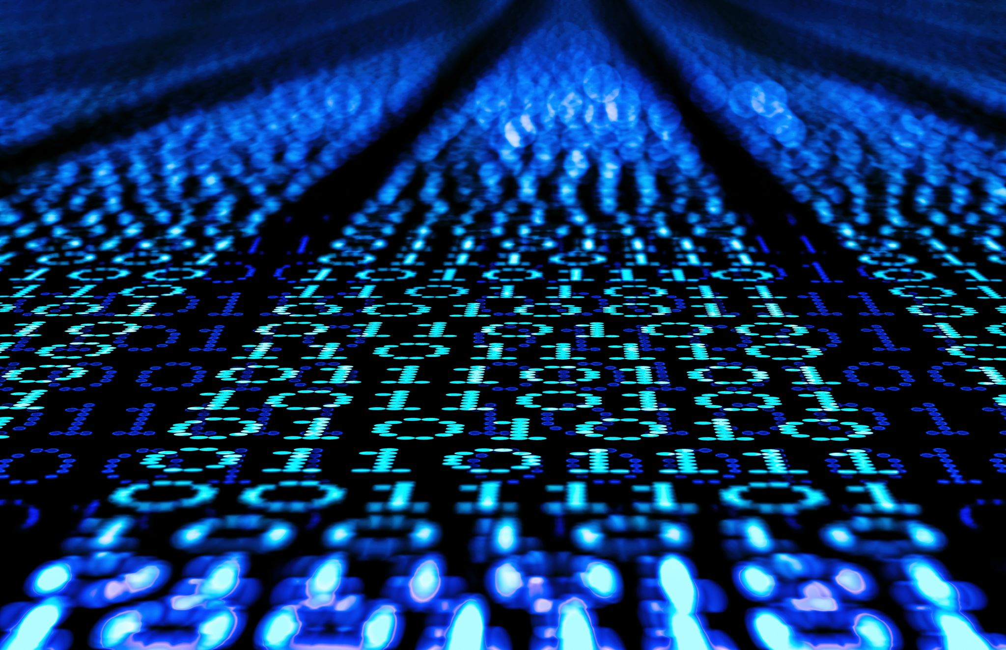
INTRODUÇÃO A PYTHON
Prof. Dr. Arthur Emanuel de Oliveira Carosia

Slide 2
Roteiro
Dia 1
Porque Python?
Introdução
Colab
Hello Word
Variáveis
Condicional
Estruturas de Repetição
Listas e Dicionários
Funções

Slide 3

Porque Python?

Slide 4
Porque Python?
Created by Guido van Rossum, and released in 1991.
It is used for:
web development (server-side),
software development,
system scripting.
Python can be used for rapid prototyping, or for production-ready software development.
Python can be used to handle big data and perform complex mathematics.
Data Science and Machine Learning
https://www.w3schools.com/python/default.asp

Slide 5
Porque Python?
Main characteristics:
Python works on different platforms (Windows, Mac, Linux, Raspberry Pi, etc).
Python has a simple syntax similar to the English language.
Python has syntax that allows developers to write programs with fewer lines than some other programming languages.
Python runs on an interpreter system, meaning that code can be executed as soon as it is written. This means that prototyping can be very quick.
Python can be treated in a procedural way, an object-oriented way or a functional way.
https://www.w3schools.com/python/default.asp

Slide 6
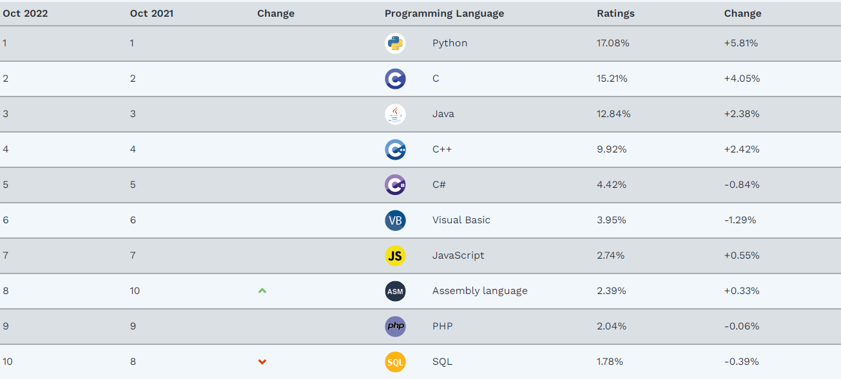
Porque Python?
https://www.tiobe.com/tiobe-index/

Slide 7
Instalação
Python
Bibliotecas Necessárias
IDE
https://www.jetbrains.com/pycharm/
https://www.liclipse.com/
https://www.python.org/downloads/
https://pypi.org/project/pip/
https://www.w3schools.com/python/python_pip.asp

Slide 8

Google Colab
"Colab notebooks allow you to combine executable code and rich text in a single document, along with images, HTML, LaTeX and more.
When you create your own Colab notebooks, they are stored in your Google Drive account. You can easily share your Colab notebooks with co-workers or friends, allowing them to comment on your notebooks or even edit them."
https://colab.research.google.com/
https://machinelearningmastery.com/google-colab-for-machine-learning-projects/

Slide 9
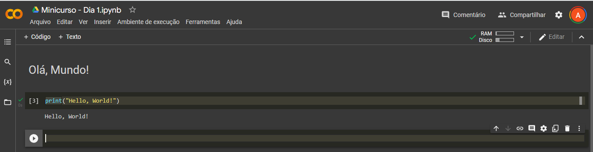
Desenvolvendo... Abrir o Colab

Slide 10
Referências
Todos os códigos estão disponíveis no GitHub
https://github.com/arthuremanuel/minicurso
Python
https://www.w3schools.com/python/default.asp

Slide 11
Roteiro
Dia 2
Data Science
Pandas
Carregando arquivos CSV
DataFrame
MatPlotLib
Correlação
Estudo de Caso: Bitcoin

Slide 12
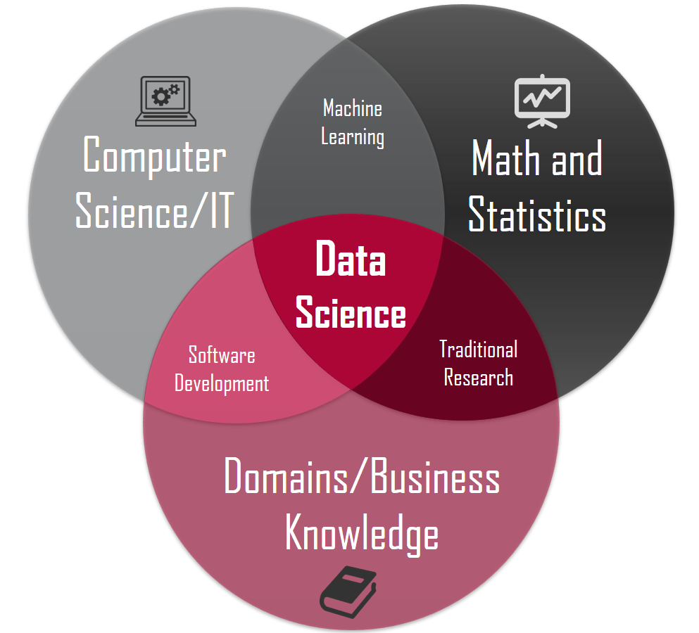
Data Science

Slide 13
Data Science
Combination of multiple disciplines that uses statistics, data analysis, and machine learning to analyze data and to extract knowledge and insights from it.
Finding patterns in data, through analysis, and make future predictions
Data gathering
Data analysis
Decision-making
Used in many industries in the world today,
Stock Market
Banking
Healthcare
Predict Elections

Slide 14
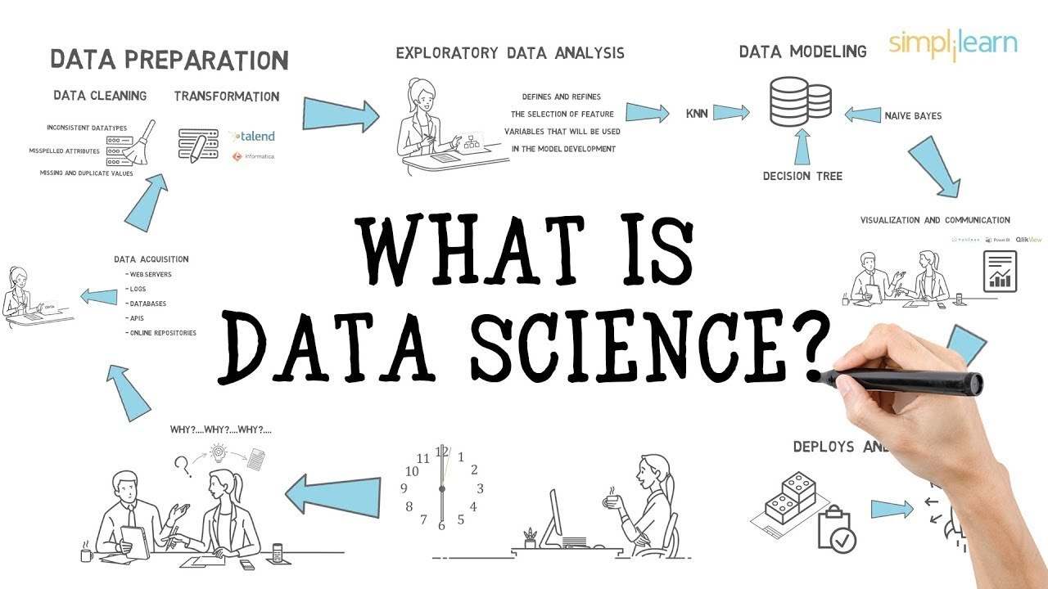
Data Science Workflow

Slide 15
Data Science & Python
Python is a programming language widely used by Data Scientists.
Python has in-built mathematical libraries and functions, making it easier to calculate mathematical problems and to perform data analysis.
Libraries: Pandas, Numpy, Matplotlib, SciPy, Scikit-Learn, ...

Slide 16
Desenvolvendo... Abrir o Colab

Slide 17
Referências
Todos os códigos estão disponíveis no GitHub
https://github.com/arthuremanuel/minicurso
Data Science
https://www.w3schools.com/datascience/default.asp
NumPy
https://www.w3schools.com/python/numpy/default.asp
Pandas
https://www.w3schools.com/python/pandas/default.asp
MatPlotLib
https://www.w3schools.com/python/matplotlib_intro.asp
Statistics
https://www.w3schools.com/statistics/index.php

Slide 18
Roteiro
Dia 3
Machine Learning
Scikit Learn
Passo 0: Definindo o problema
Passo 1: Descrevendo os Dados
Passo 2: Conjuntos de Dados - Treinamento e Teste
Passo 3: Utilizando Regressão Linear para Previsão
Passo 4: Visualizando os Resultados

Slide 19
Machine Learning
"Machine Learning is a subfield of computer science that gives computers the ability to learn without being programmed"
Arthur Samuel, IBM Journal of Research and Development, Vol. 3, 1959.

Slide 20
Machine Learning
Today, Artificial Intelligence is usually referring to Machine Learning technologies.
While traditional computer programming uses rules (algorithms) created by humans, machine learning uses technologies where the rules (algorithms) are created from the input data (on which the system is trained).
Classical programming uses programs to create results:
Data + Computer Program = Result
Machine Learning uses results to create programs (algorithms):
Data + Result = Computer Program

Slide 21
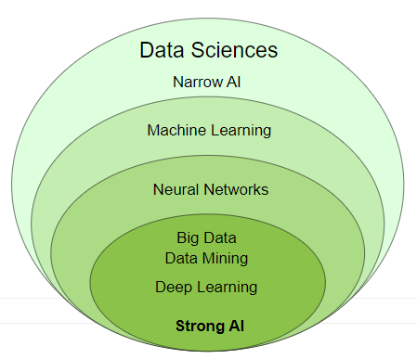
Machine Learning

Slide 22
Machine Learning Applications
Natural Language Processing
Search Engines
Social Media
Automated Investment
Email spam Filters
Text to Speech
Speech Recognition
Language Translation
Chatbots
Netflix's Recommendations
Apple's Siri
Microsoft's Cortana
Amazon's Alexa
IBM's Watson
Visual Perception
Face Recognition

Slide 23
Languages
LISP
R
Python
C++
Java
JavaScript
SQL

Slide 24
Desenvolvendo... Abrir o Colab

Slide 25
Referências
Todos os códigos estão disponíveis no GitHub
https://github.com/arthuremanuel/minicurso
Machine Learning and AI
https://www.w3schools.com/python/python_ml_getting_started.asp
https://www.w3schools.com/ai/default.asp
https://www.w3schools.com/datascience/ds_linear_regression.asp
Pandas
https://www.w3schools.com/python/pandas/default.asp
Scipy
https://www.w3schools.com/python/scipy/index.php
Scikit Learn
https://scikit-learn.org/stable/

Slide 26
INTRODUÇÃO A PYTHON
Prof. Dr. Arthur Emanuel de Oliveira Carosia

